Slide 1

Robogals Info Session
March 10th, 6:30-7pm

Slide 2
WHO WE ARE
OUR PURPOSE
A non-profit, international, student-run organization that engages girls in science and technology via robotics workshops
To increase the number of young women pursuing engineering in higher education and future careers.

Slide 3
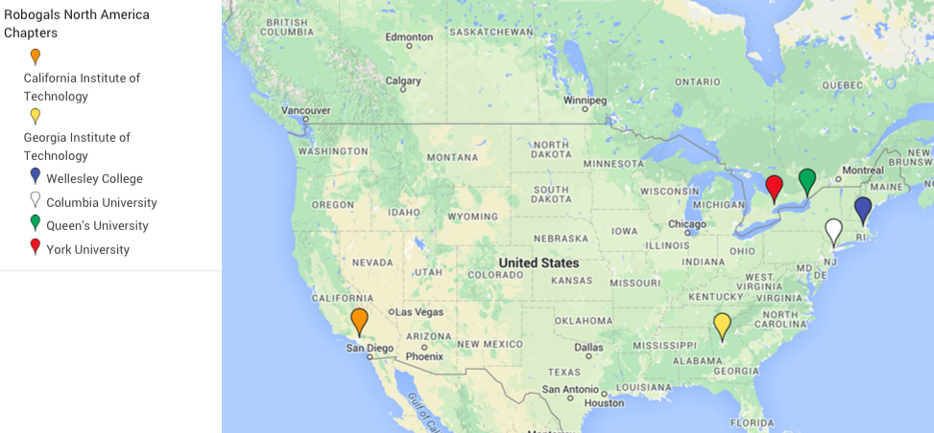
ABOUT
July 2008 - Founded at the University of Melbourne by Marita Cheng
Today -
21 chapters around the world
6 chapters in North America

Slide 4
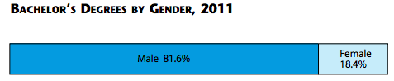
WHY?
Overall, women have higher college graduation rates compared to men.
However, men disproportionately outnumber women in the number of STEM degrees received.
In 2004, there were approximately 192,900 female engineers in the US compared with over 1,515,000 men. This means that only 11% of the engineering workforce were women.
In 2011, the percentage of women receiving their Bachelor’s degree in any engineering field was just 18.4%.

Slide 5
BUT REALLY… WHY?
We have a major engineering skills shortage, not just in the US but worldwide.
We are missing out on the engineering inputs, ideas, and innovations of HALF of our population!
“Women’s voices are essential to the problem solving and innovation that is at the heart of engineering. We must re-imagine what an engineer and a leader looks like so we can tap into this critical half of the human talent pool.”

Slide 6
WHAT WE DO
Robotics Workshops at Local Schools - Our Main Activity!
Consists of an introduction to engineering, building and programming LEGO NXT robots
Engineering Workshops/Events in the Community
Conduct workshops in community centers, libraries, GT campus, work offices, etc!
SINE (Seminar Inducting New Executives)
Annual regional conference to train new executives and re-energize returning execs
Opportunity for chapters to meet, share best practices, and network
Robogals Science Challenge
Web-based competition where students conduct a STEM related experiment, document it, and submit it to for a prize!
To be introduced in the North American Region!

Slide 7
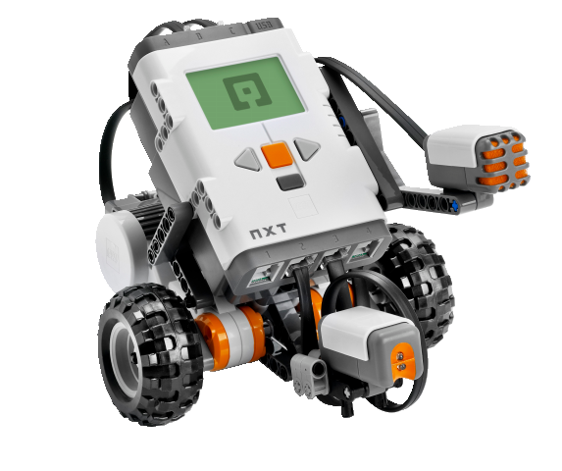
WORKSHOPS
Who: K-12th grade with focus on 4th-8th grade girls*
Where: Mainly local schools around Atlanta
What: Focus on robotics workshops using the LEGO Mindstorms NXTs
Alternative STEM workshops include
non-tech (spaghetti towers) and high tech (teaching coding skills, 3D modeling software, etc) workshops
*Middle school is a critical decision-making time for female students

Slide 8
COMMITTEES
If you have an idea, start a COMMITTEE!
Committees allow our volunteers to take charge of an idea or goal for Robogals and implement it!
Want to teach a STEM skill not yet discussed?
Want to start a specific STEM program in your local town?
Want to explore alternative robots for Robogals besides the NXTs?
Want to bring the Robogals Science Challenge to North America?
Then start a committee!

Slide 9
UPCOMING EVENTS
March 23rd - Workshop 1 with GVP (1 class)
3:45pm-4:45pm
March 24th - Volunteer Training Session: REQ for Workshop 2
6pm - 7pm in Klaus 2448
March 26th - Workshop 2 with GVP (3 classes)
8:45am - 12pm
March 29th - Kids@Kollege
10am - 5pm (400+ kids!!)
GVP: The Global Village Project is a special purpose middle school for refugee girls who have had interrupted or no education.
1 hour per class (8-13 girls), robots will be prebuilt

Slide 10
HOW TO JOIN
[Go to my.robogals.org/join/Georgia]*
*currently down
Sign up on our forum: http://goo.gl/forms/FxJfTa1gHN
Like us on Facebook: Robogals Georgia Tech
Look out for FB updates and emails regarding training sessions and workshops!
Remind your friends to join!

